Slide 1
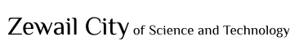
1
Quadrature Phase Shift Keying (QPSK)
Prepared By:
Shehab Bahaa 201700313
Ahmed Hashem 201700988
Mohamed Roshdy 201701098
Supervised By:
Dr. Ahmed Eltrass
NANENG 461 - Spring 2021
Final Project

Slide 2
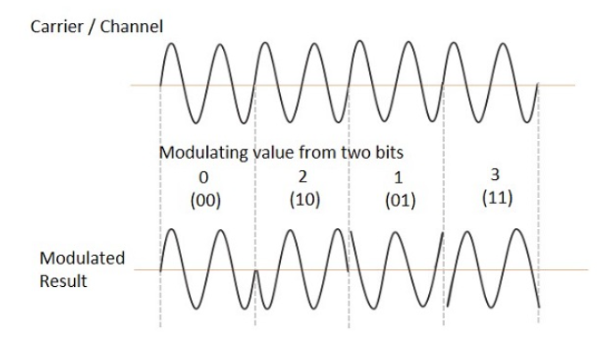
1
Introduction
Quadratic phase shift keying (QPSK) Modulation technique transmits two bits per symbol. A QPSK symbol represents 00, 01, 10, or 11.
The carrier varies in terms of phase, and it is depending on four possible phase shifts, Basically we are working with 0, 90, 180, 270 in degrees
The waveform of QPSK is as follows, which shows the modulated result for different instances of binary inputs [5]:
Figure (1)
NANENG 461 - Spring 2021
Final Project

Slide 3
2
Applications
Due to its performance on bandwidth efficiency and bit rate error so it is used in wireless communication asd satellite transmission.
QPSK allow the signal to carry twice as much as the ordinary BPSK Technique.
Video conferencing.
Cable modems.
Figure (1)
NANENG 461 - Spring 2021
Final Project

Slide 4
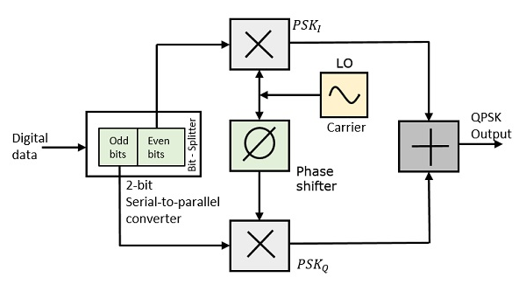
3
QPSK Modulator
In the following diagram [5] we can find the QPSK Modulator circuit block which consists of :
Figure (2)
NANENG 461 - Spring 2021
Final Project

Slide 6
4
QPSK Modulator (The Actual Hardware)
Proposed designs
For Bit-splitter we used serial to parallel converter then we obtain the phase shifts from 2 possible ways the first was by RC configurations, and was replaced to phase shifted signals from function generator due to noise added to the signal.
4 connected diodes used to obtain multiplication between carrier signal and Bits.
Op-amp summing amplifier
This procedure had a lot of difficulties, and the output was not as expected so we started to debug each output from each component. Finally, we could not figure out where the error came from, so we changed our methodology.
NANENG 461 - Spring 2021
Final Project

Slide 7
5
QPSK Modulator (The Actual Hardware)
Proposed designs
As before we used function generator again but now we stored shifted signals as input for 4-to-1 analog mux with the bits 00,01,11,10 as the select signal.
This procedure was fine at the beginning, the output of the mux was shifted signals but the peak to peak was somewhat less than the generated. Also, we had a major problem with the received signal. Outputs from mux for a pattern of 1’s and 0’s somewhat differ and may alter the required pattern.
NANENG 461 - Spring 2021
Final Project

Slide 8
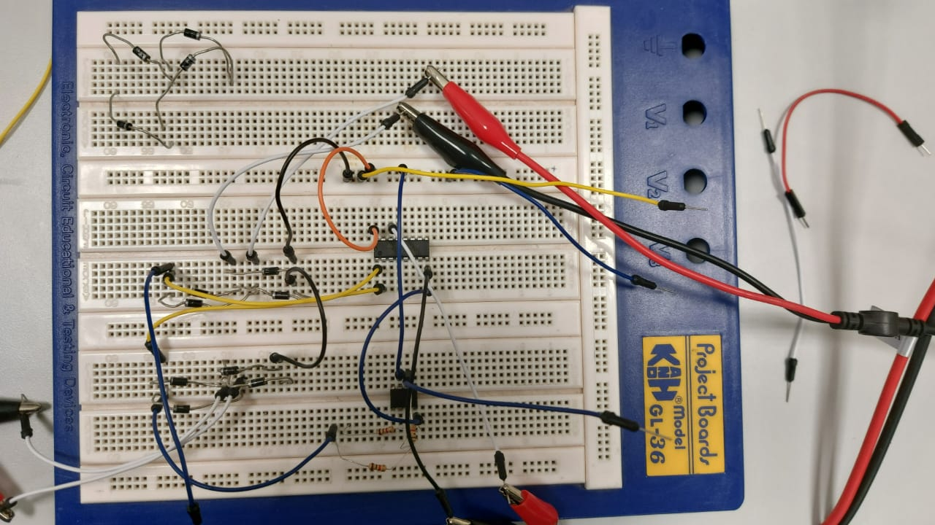
6
QPSK Modulator (The Actual Hardware)
In the following diagram, we can find the QPSK Modulator circuit block which consists of:
two multipliers (each 4 Diodes)
A 8-bit serial to parallel converter (SIPO)
A summing Amplifier
Figure (3)
NANENG 461 - Spring 2021
Final Project

Slide 9
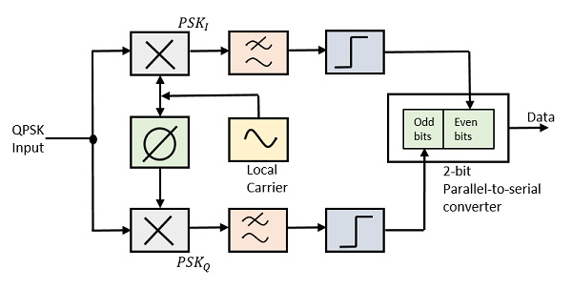
7
QPSK Demodulator
In the following diagram, we can find the QPSK Modulator circuit block which consists of:
two multipliers (each 4 Diodes)
A 2-bit serial to parallel converter (PISO)
Two band pass filters.
Two integrator circuits.
Figure (4)
NANENG 461 - Spring 2021
Final Project

Slide 10
MATLAB Simulation
NANENG 461 - Spring 2021
Final Project

Slide 11
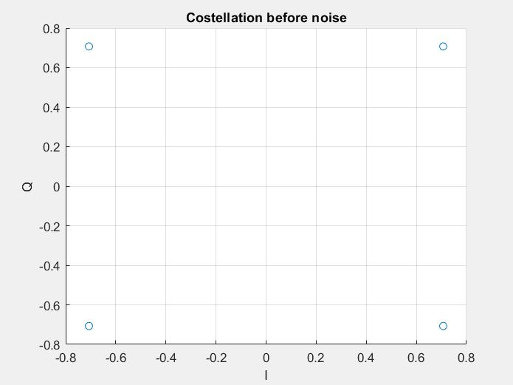
8
Constellation Diagram before channel
NANENG 461 - Spring 2021
Final Project

Slide 12
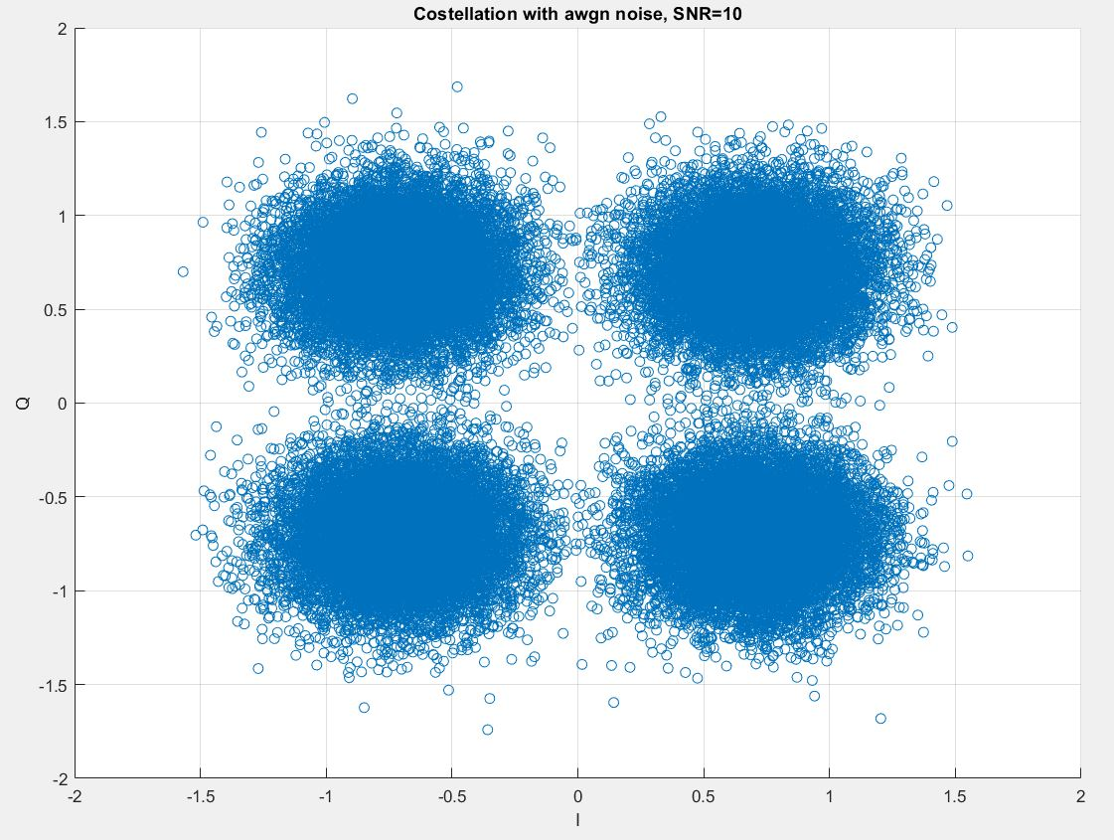
4
Constellation with awgn noise, SNR=10
NANENG 461 - Spring 2021
Final Project

Slide 13
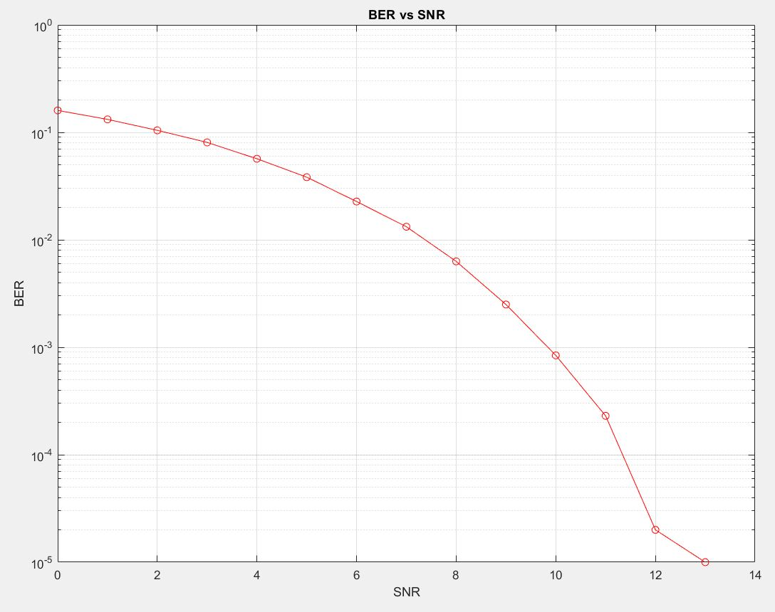
9
BER vs SNR curve with only noise in the channel
NANENG 461 - Spring 2021
Final Project

Slide 14
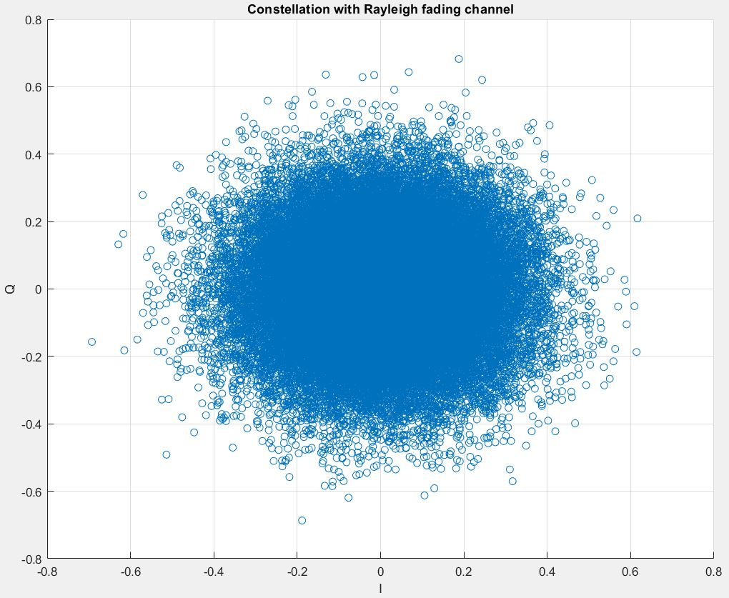
10
Constellation Diagram for Rayleigh Fading Channel
NANENG 461 - Spring 2021
Final Project

Slide 15
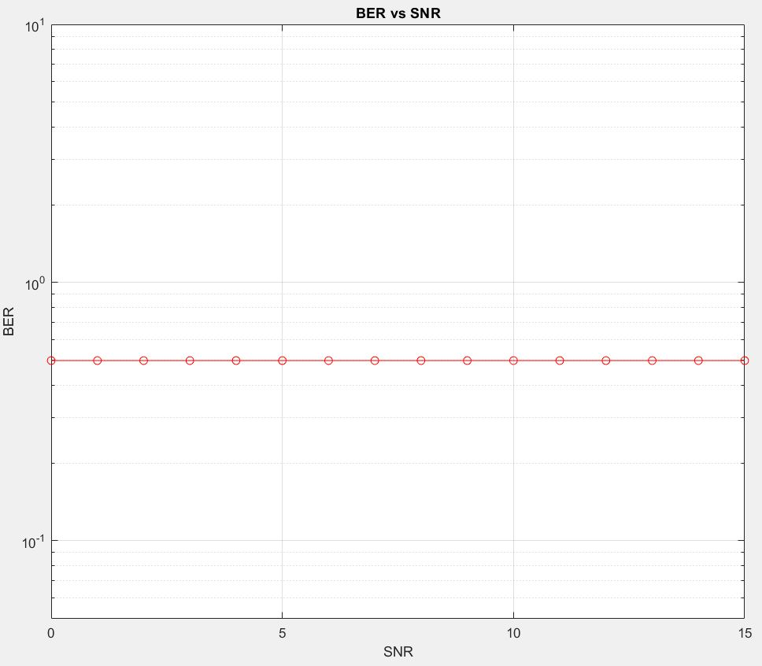
11
BER vs SNR curve with Rayleigh and no noise
NANENG 461 - Spring 2021
Final Project

Slide 16
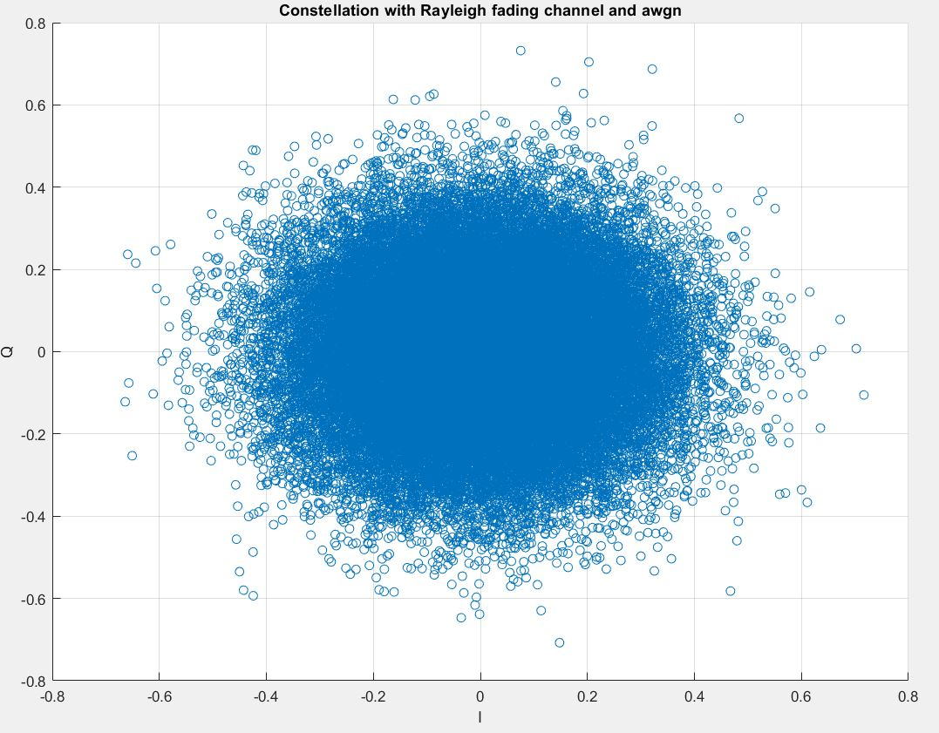
12
Constellation Diagram for Rayleigh Fading Channel
NANENG 461 - Spring 2021
Final Project

Slide 17
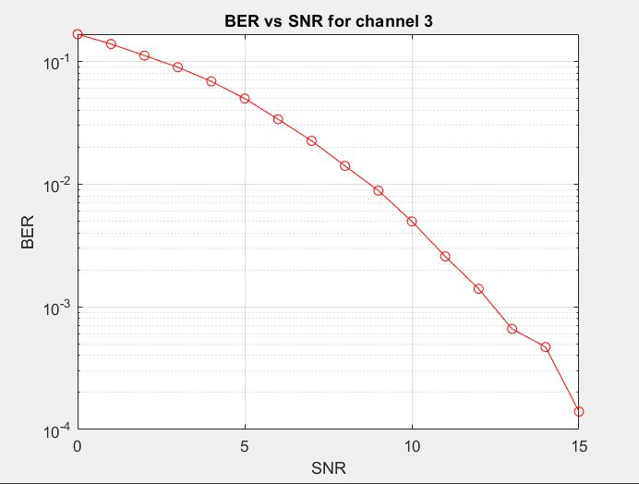
13
BER vs SNR curve with only noise in the channel
NANENG 461 - Spring 2021
Final Project

Slide 18
14
References
[1] Quadrature Phase Shift Keying https://www.tutorialspoint.com/digital_communication/digital_communication_quadrature_phase_shift_keying.htm
NANENG 461 - Spring 2021
Final Project

